Slide 1
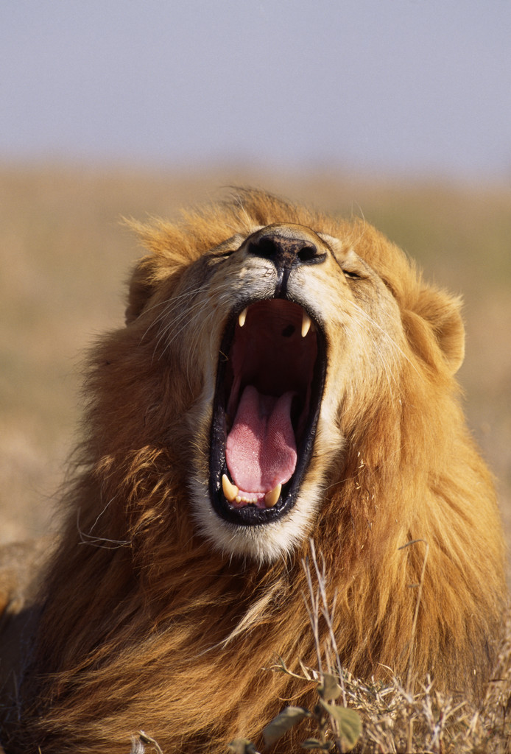
Welcome Parents and Students!

Slide 2
About me…
Karen Harker, originally from Morgan City, Louisiana and Greenville, North Carolina
Graduated from East Carolina University in 2010
Studied abroad at Cambridge University in Cambridge, England (2008), in Ballinderry, Ireland (2009), and as a graduate student in London, England (2012)
North Carolina Teaching Fellow
Teacher consultant for National Writing Project
Previously taught at Ayden-Grifton High School in Ayden, NC
Second year at Leesville Road High School
Shakespeare fanatic!!!

Slide 3
What will we do in Creative Writing?
WRITE EVERY DAY ☺
Read - We will learn to read works like writers rather than for mere comprehension.
Edit and polish drafts – Students will spend time revising their own drafts and the work of their classmates.
Think, Imagine, Create, and Learn!
This course is intended for students who enjoy writing and is not intended to be a remedial writing course.

Slide 4
A Brief Outline of the Course
Creative Writing Unit Breakdown
Essay/Narrative
Short Fiction
Poetry
Theatre
Film/Digital Media
Final Exam
Portfolio: Students will complete a portfolio that will be due on exam day that will count as 50% of the final exam grade. The portfolio will consist of writing from all units throughout the semester and is meant to serve as a culminating project.
Written Reflection: The other 50% of the exam will require the student to reflect on his/her progress throughout the semester and require some original writing.

Slide 5
What will you need?
Marble composition book (Daybook)
Highlighters (at least 4 different colors)
Pens/Pencils
Scissors
Glue Stick
Flash drive (if you don’t already have one)

Slide 6
Daybooks
A daybook is a type of writer’s notebook/journal/diary/scrapbook that has been proven as an effective tool for writers.
It encourages creative thought, critical thinking, and keeps all important information in one place and easily accessible for the writer.
In order for a student to be successful in Creative Writing, he/she MUST have his/her daybook EVERY day.

Slide 7
Classroom Rules
Come to class prepared, on time, and in dress code
Eating in class is prohibited, but drinks with a cap are allowed
No cell phones or electronic devices
Stay on task for the entire 90 minute class period
Respect everyone – zero tolerance for bullying
Refrain from using profanity and derogatory language

Slide 8
Grade Distribution
Homework/Classwork/Class Participation – 20%
Daybook and Minor Assessments– 30%
Polished Drafts, Projects, Major Assessments– 50%

Slide 9
Grading
Due to the nature of the course, the majority of your child’s grade will be made up of daily class participation and his/her submitted writing. There are few tests and quizzes of the traditional sense in a Creative Writing course.
In order to have an A in Creative Writing, students will need to:
Turn in all writing assignments
Provide quality work and best effort on all assignments
Actively participate in class each day
Read all assigned readings and prepare to discuss in class
Actively participate in all writing workshops

Slide 10
Make-up Work
Papers:
Because papers are assigned well in advance, students are expected to turn in their papers the day they return from being absent.
If a student does not have his/her paper on the due date, 10% will be deducted for each day that it is late.
Please note that all assignments will only be accepted in hard copy. Your child should have adequate access to a printer or should arrange time to use the printers at school before a paper is due.
Homework/Classwork:
If a student’s absences is excused, he/she can make up any homework/classwork missed.
If absence is unexcused, he/she can make up work missed for 70% of the grade.

Slide 11
Class Support and Teacher Support
Make-up Work/Tutoring
Before school by appt
Pride Period
After school on Tuesdays and Thursdays from 2:30-3:30
Teacher Contact
kharker@wcpss.net
http://harkerpride.weebly.com
2nd period planning

