Slide 1
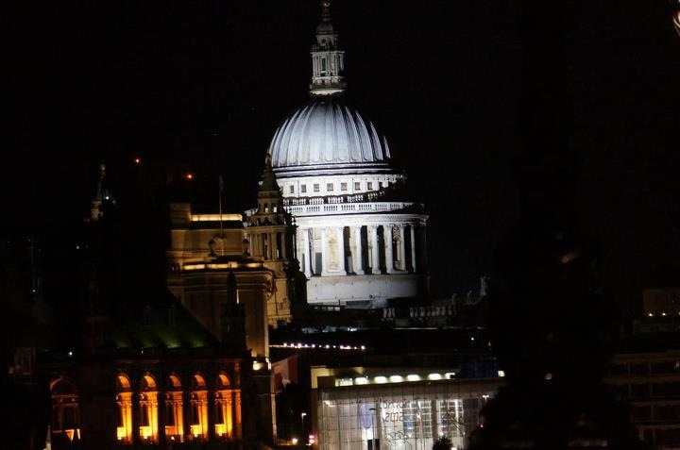
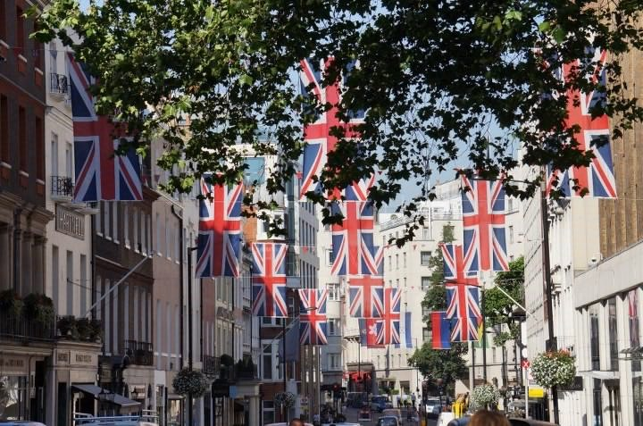
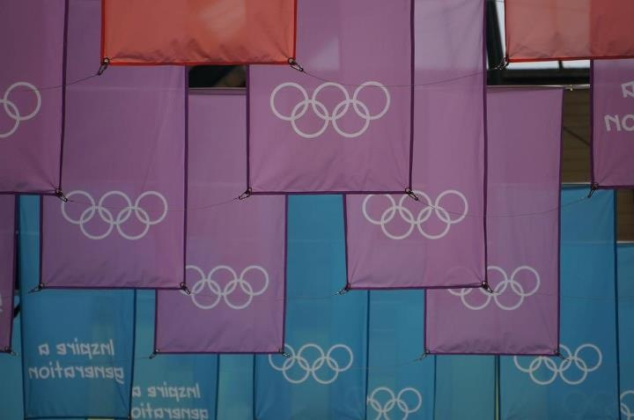
Welcome Parents and Students!

Slide 2
About me…
Karen Harker, originally from Morgan City, Louisiana and Greenville, North Carolina
Graduated from East Carolina University in 2010
Studied abroad at Cambridge University in Cambridge, England (2008), in Ballinderry, Ireland (2009), and as a graduate student in London, England (2012)
North Carolina Teaching Fellow
Teacher consultant for National Writing Project
Previously taught at Ayden-Grifton High School in Ayden, NC
Second year at Leesville Road High School
Shakespeare fanatic!!!

Slide 3
What you will need
A three-ring binder with plenty of notebook paper
Pens/Pencils
Flash drive

Slide 4
What will we learn?
Reading
A Raisin in the Sun
Excerpts from The Odyssey
Romeo and Juliet
Fahrenheit 451
To Kill a Mockingbird
Selected short stories and poetry
Selected non-fiction and US seminal documents
Writing/Projects
Introductory Letter
This I Believe Essay
Argumentative Writing
Research-based writing
Staged Readings – Romeo and Juliet
Literary analysis essay
Film review
Spoken Presentations
Plus Grammar, Punctuation, Usage, and Vocabulary ☺

Slide 5
Classroom Rules
Come to class prepared, on time, and in dress code
Eating in class is prohibited, but drinks with a cap are allowed
Stay on task for the entire 90 minute class period
Respect everyone – zero tolerance for bullying
Refrain from using profanity and derogatory language

Slide 6
Make-up Work – Homework and Classwork
Homework:
Homework that is collected and reviewed by teacher (e.g short writing, pre-writing for an essay, etc.) will be accepted up to two days late for excused absences only.
Classwork:
Students present in class when class work is assigned and do not complete it will receive a zero.
Students with excused absences obtain it when they return to class and complete it in the allotted make-up period.
UNEXCUSED absences will be able to make up class work; however, they will only receive may only earn up to 70% of the grade .

Slide 7
Make-up Work – Projects and Papers
Students absent on the day a paper/project is due are required to turn it in on the day they return to class.
If a project is late due to an UNEXCUSED absence you will be penalized 10% each day it is late.
If you are present in class on the day a paper/project is due, but you do not have it, it will be accepted late, but penalized 10% for each day it is late.

Slide 8
Make-up Work – Quizzes and Tests
The STUDENT should schedule make-up within one week of the date it was administered
For missed quizzes/tests, due to UNEXCUSED absences, students may only earn up to 70% of the grade
**The student will be responsible for scheduling make up times with me. Failure to do so will result in a zero on the assignment.

Slide 9
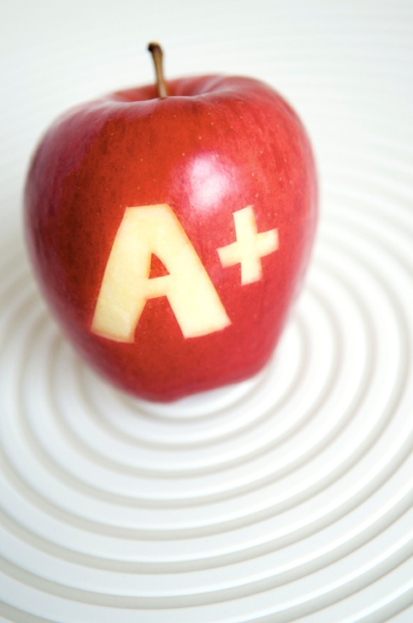
Grade Distribution
Major Assessments (e.g. papers, major tests, and projects) – 50%
Minor Assessments (e.g. quizzes, minor projects) – 35%
Homework/Classwork – 15%
Final Exam:
The final exam for all English I classes will be a state-made MSL (Measure of Student Learning). This test will encompass reading comprehension, understanding of literary concepts, grammar competency, and writing ability. The final exam will count as 20% of the final grade in English I.

Slide 10
Class Support and Teacher Contact
Make-up Work/Tutoring
Before school by appt
Pride Period
After school on Tuesdays and Thursdays from 2:30-3:30
Teacher Contact
kharker@wcpss.net
http://harkerpride.weebly.com
2nd period planning

